Slide 1
BCI - Motor Imagery Classification
ARCHANA

Slide 2
Problem Statement & System Model
Explore various methods for efficient classification of EEG time series data.
Model :
Pre Processing
artifact removal
Feature Extraction
PSD
CSP
Spiking Model
Optimization
PSO
Classifier
KNN
SVM

Slide 3
Literary survey
Carlos D. Virgilio G., Juan H. Sossa A., Javier M. Antelis, Luis E. Falcón, Spiking Neural Networks applied to the classification of motor tasks in EEG signals, Neural Networks, Volume 122,2020, Pages 130-143, ISSN 0893-6080,https://doi.org/10.1016/j.neunet.2019.09.037
Izhikevich, E. M. (2004). Which model to use for cortical spiking neurons? IEEE Transactions on Neural Networks, [ISSN: 1045-9227] 15(5), 1063–1070.http://dx.doi.org/10.1109/TNN.2004.832719.
Kai Keng Ang, Zheng Yang Chin, Haihong Zhang, and Cuntai Guan, "Filter Bank Common Spatial Pattern (FBCSP) in Brain-Computer Interface," 2008 IEEE International Joint Conference on Neural Networks (IEEE World Congress on Computational Intelligence), Hong Kong, 2008, pp. 2390-2397.doi: 10.1109/IJCNN.2008.4634130
EEG-Based Brain-Controlled Mobile Robots:A Survey,IEEE TRANSACTIONS ON HUMAN-MACHINE SYSTEMS, VOL. 43, NO. 2, MARCH 2013

Slide 4
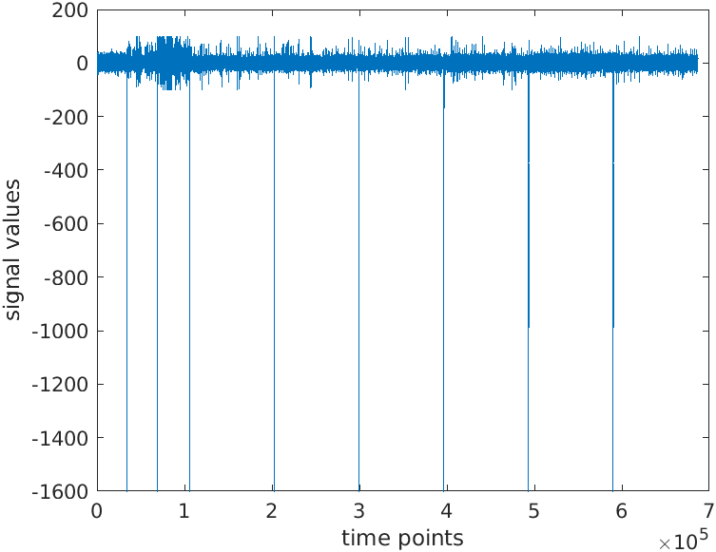
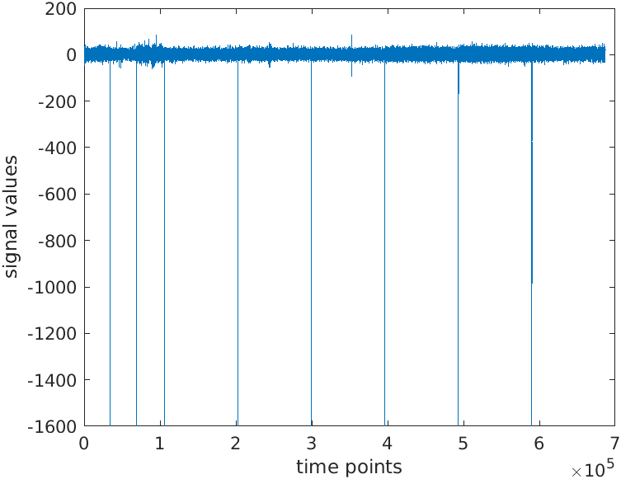
Pre Processing
Artifact Removal
Regress EOG
Feature Extraction
Power Spectrum
BandPower(Power Spectrum)
8-30 Hz band filter
Notes:
In order to obtain the corrected signal S = Y - U.b, the noise source U and its weighting coefficients b must be known. In this work, the noise source (i.e. EOG) was recorded by separate EOG channels. In order to identify the weighting coefficients b, we assume the signal S (i.e. EEG) and the noise U (i.e. EOG) are independent, then < UTS >¼< UTY > < UTU > b with = 0 results in b ¼< UTU>1 < UTY >¼ C1 NN CNY with CNN = is the auto-covariance matrix of the EOG channels and CNY = is the cross-covariance between the EEG and EOG channels. Accordingly, the EEG can be corrected by the following equation: S ¼ Y U b
This is because the power spectral changes have been well established in the motor-related brain rhythms during execution, imagination or attempt to perform movements

Slide 5
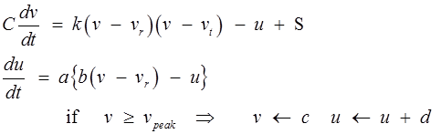
Feature Extraction..
CSP
Orthogonalizes the points of two classes
One vs Rest
Izhikevich Neuron Model
Good in terms of computational complexity as well as biological similarity.
v-membrane potential, u-recovery variable

Slide 6
Why Spiking Neuron model?
In traditional neural network models, we do not consider the temporal features in the trails.
Biologically,Neuron fires as a consequence of the membrane potential crossing a threshold.
Firing of the neuron is modeled as a differential equation.

Slide 7
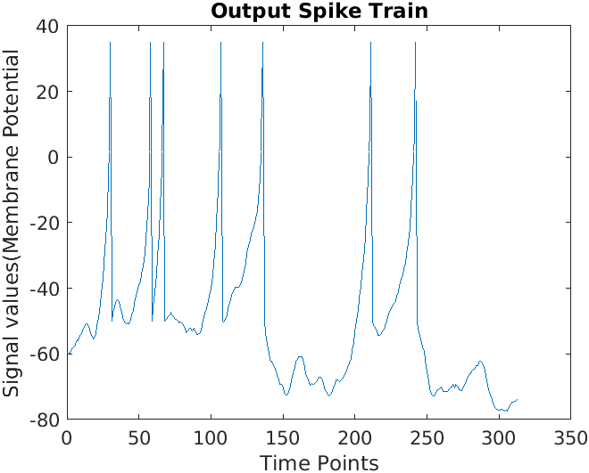
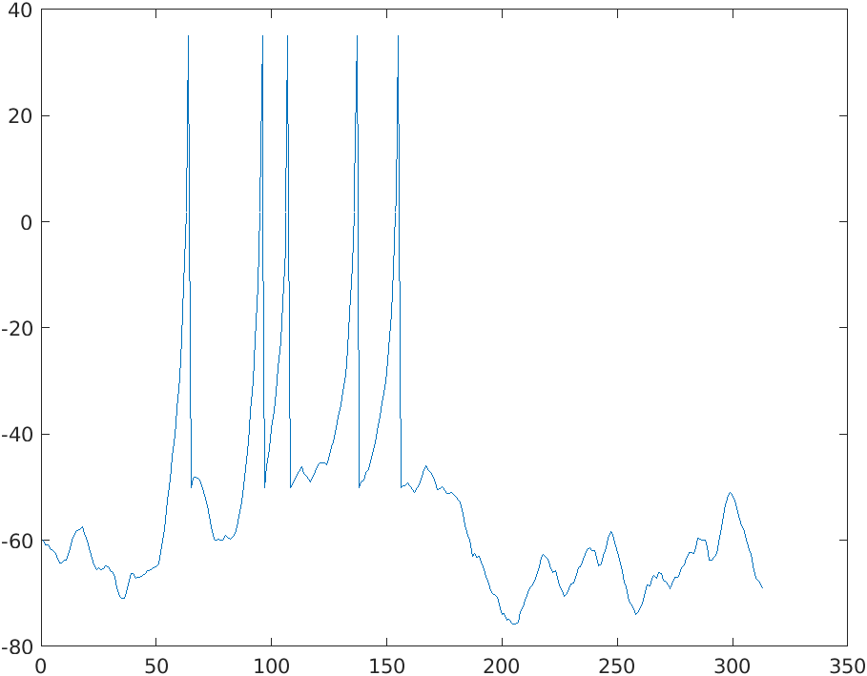
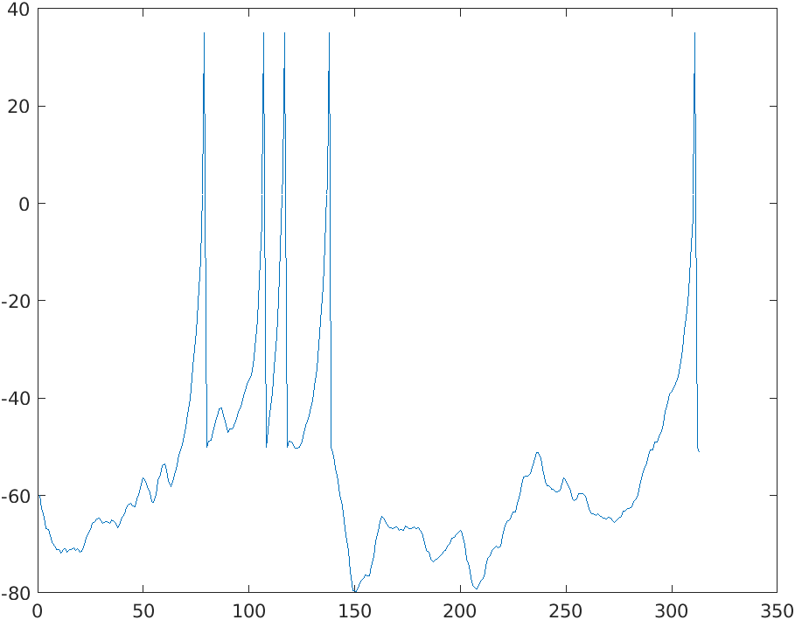
Spike Train Analysis
Input : Weighted sum of the features
Output : Spike train
Coding of Spikes
Number of Spikes
Event=Tongue, Trail 1. Event=foot, Trail 1.

Slide 8
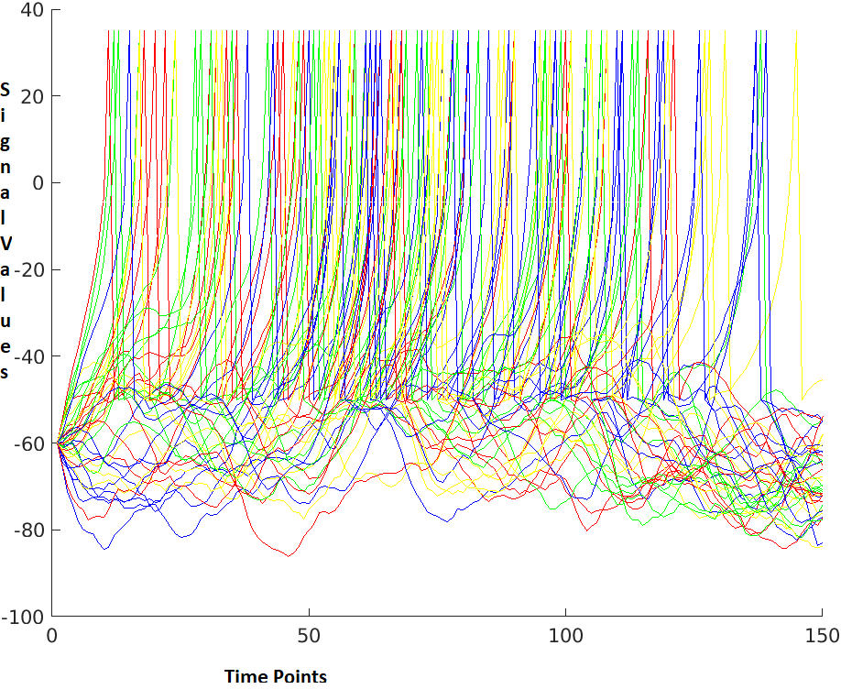
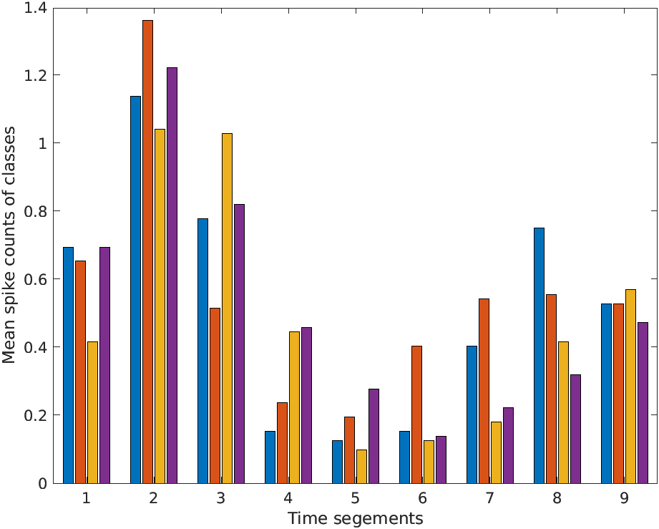
Spike frequency in time intervals

Slide 9
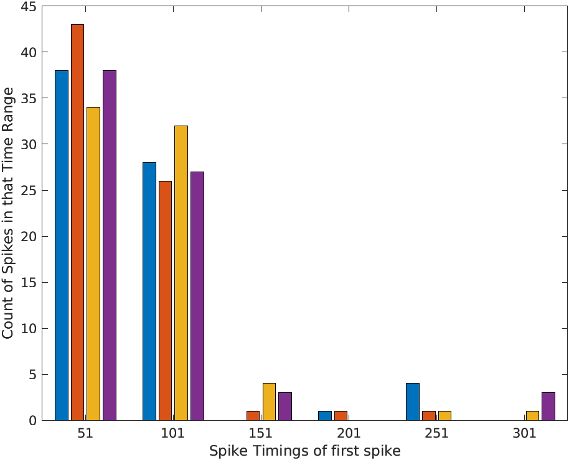
First Spike arrival time

Slide 10
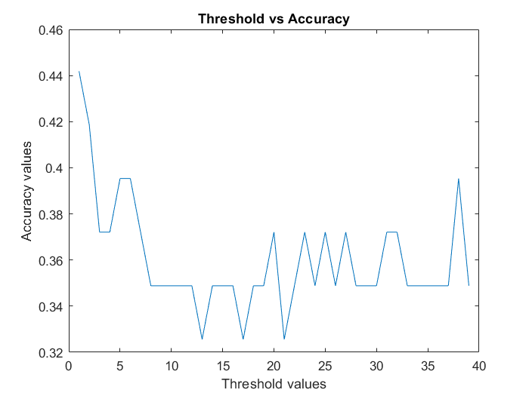
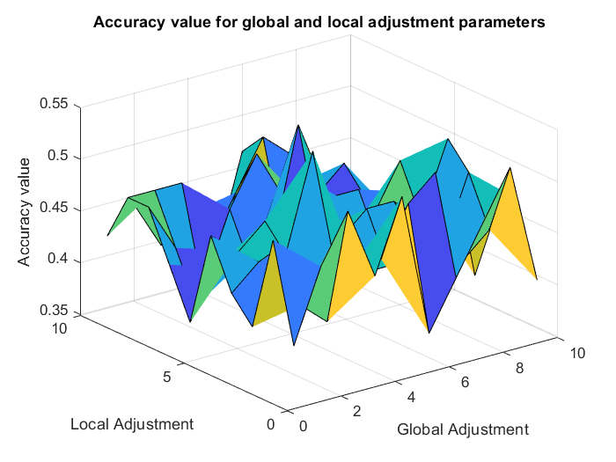
Parameter Tuning
Firing Threshold
Single threshold
Two thresholds
Weights Optimization
Particle Swarm Optimization
Global,self adjustment tuning
Notes:
v[] = v[] + c1 * rand() * (pbest[] - present[]) + c2 * rand() * (gbest[] - present[]) (a)
present[] = persent[] + v[] (b)

Slide 11
Results
Accuracy values for KNN and SVM with CSP (averaged across 9 subjects)
KNN(k=9) : 94.3 %
SVM : 86.3 %
Accuracy values for Spiking and SVM (With PSO optimized weights)
SVM : 41.73 %

Slide 12
Future Work
Accuracy of the spiking model : better coding of spike trains.(Temporal codes like precisely timed groups of spikes)
Hyperparameter tuning can be done in PSO as well as SVM.

